Slide 1
DS-UNIT-IV
Model Evaluation and Selection,
Techniques to Improve Classification Accuracy.

Slide 2
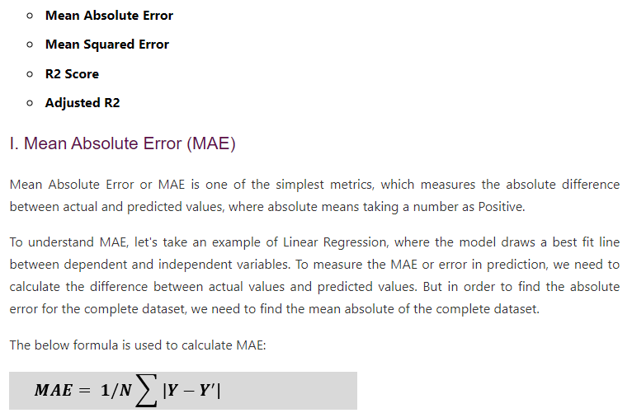
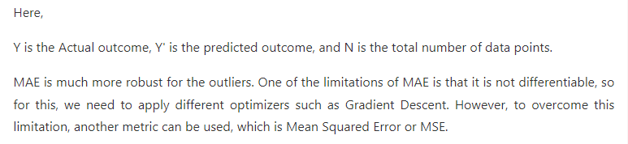
Regression performance metrics

Slide 3
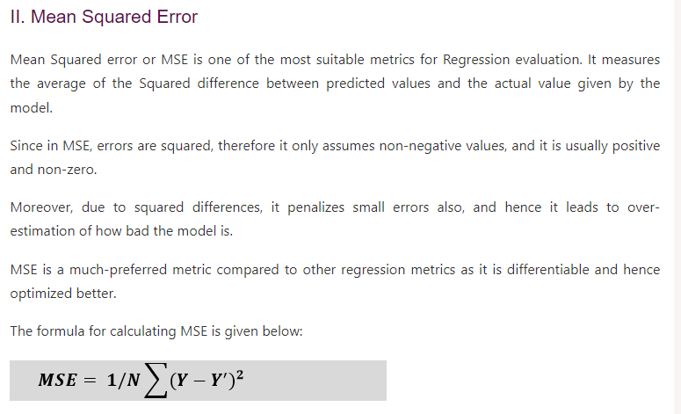

Slide 4
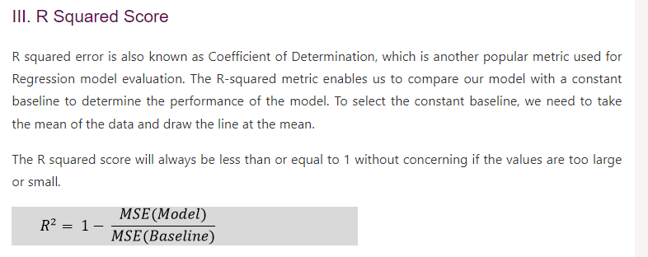

Slide 5
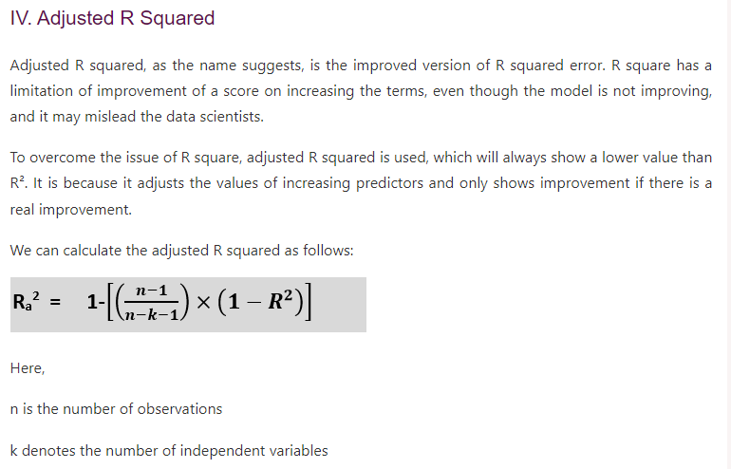

Slide 6
Classification Model Evaluation Metrics
6

Slide 7
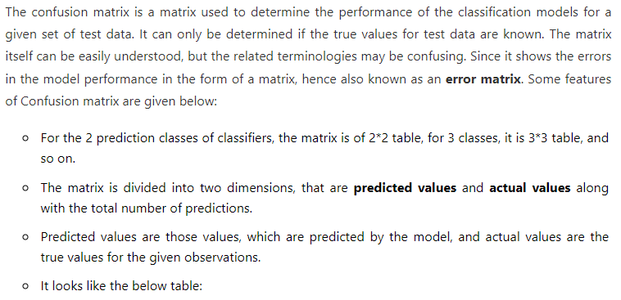
Classification Model Evaluation Metrics: Confusion Matrix
Confusion matrix is a simple table used to measure how well a classification model is performing. It compares the predictions made by the model with the actual results and shows where the model was right or wrong.

Slide 8
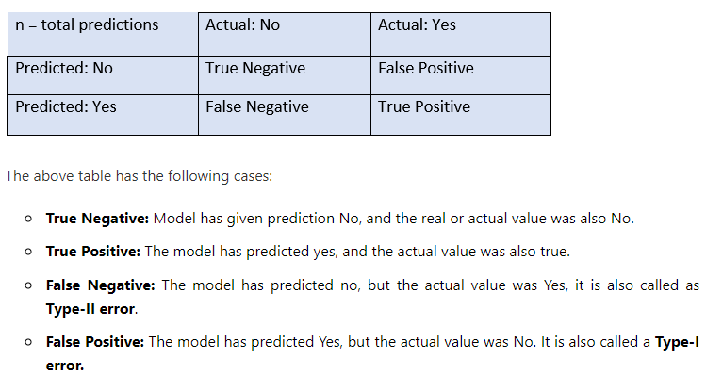
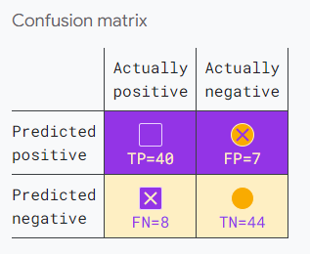

Slide 9
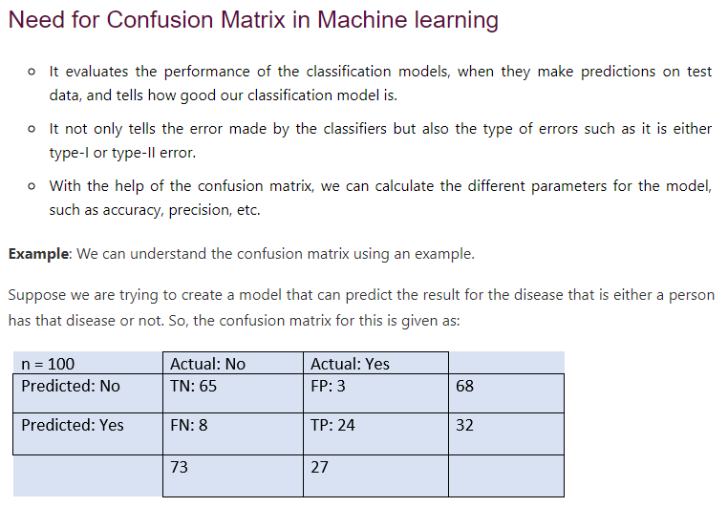

Slide 10
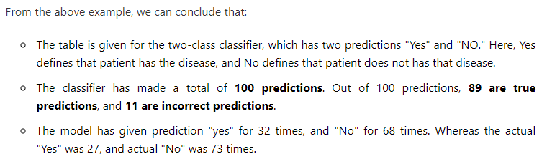

Slide 11
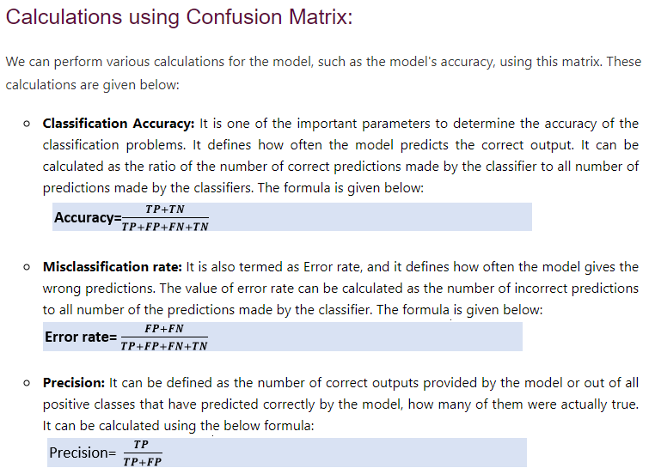

Slide 13
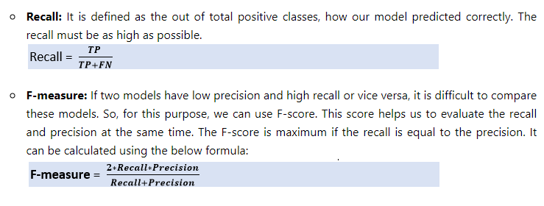

Slide 14
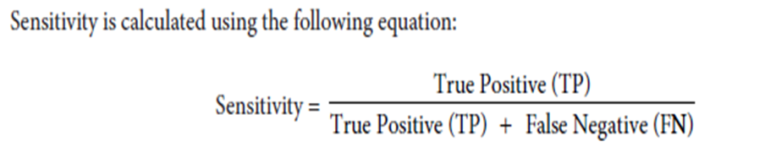
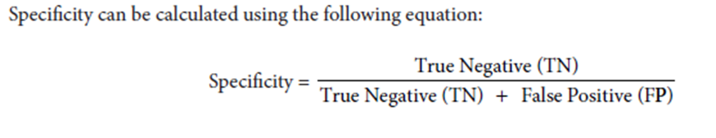
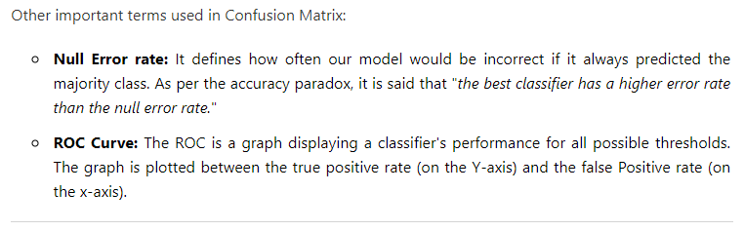

Slide 15
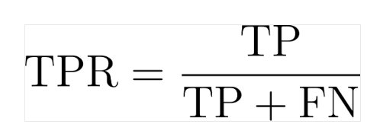
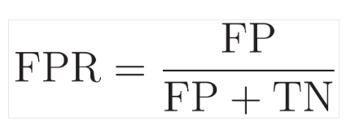
ROC Curve(Receiver Operating Characteristic curve)
A ROC curve (Receiver Operating Characteristic curve) is a graphical plot that shows the diagnostic ability of a binary classifier system by plotting the True Positive Rate (Sensitivity) against the False Positive Rate (1 - Specificity) at various threshold settings.
True positive rate
The true positive rate, also known as sensitivity or recall, reflects a model’s ability to correctly identify positive instances.
False positive rate
FPR represents how often our model incorrectly classifies negative class instances as positive. It measures the proportion of actual negative instances that are incorrectly identified as positive by the model

Slide 16
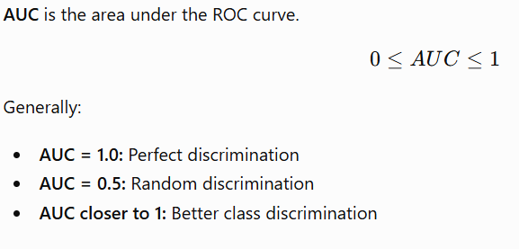
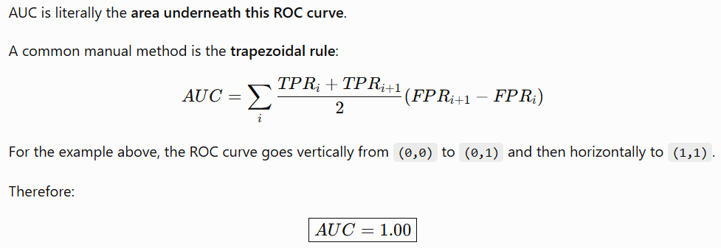

Slide 17
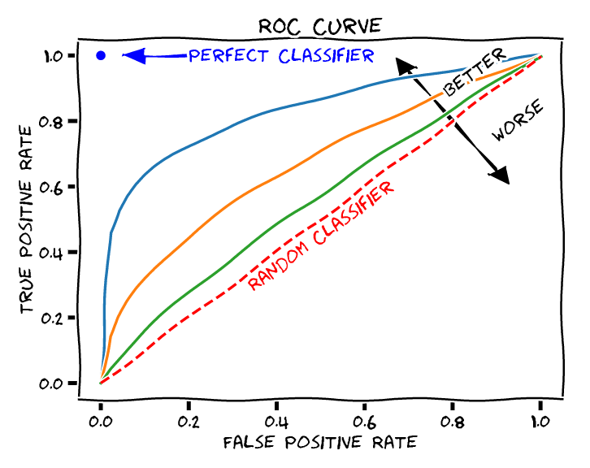
Threshold:
The cut-off value used to convert continuous model outputs into binary predictions (positive or negative). The ROC curve illustrates how the TPR and FPR change as the threshold varies.
Area Under the Curve (AUC):
A single metric representing the overall performance of the classifier.
An AUC of 1.0 indicates a perfect classifier, while an AUC of 0.5 (the diagonal line) indicates performance no better than random chance.

Slide 18
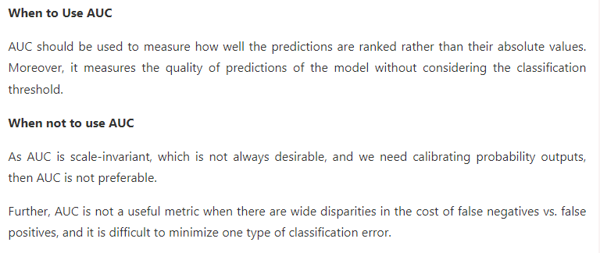

Slide 19
Techniques To Evaluate Accuracy of Classifier
  Holdout method,
  Random subsampling
  Cross-validation
  Bootstrap
19

Slide 20
Techniques To Evaluate Accuracy of Classifier : Hold Out Method
The largest dataset is randomly divided into three subsets:
A training set is a subset of the dataset which are been used to build predictive models.
The validation set is a subset of the dataset which is been used to assess the performance of the model built in the training phase. It provides a test platform for fine-tuning of the model's parameters and selecting the best-performing model. It is not necessary for all modeling algorithms to need a validation set.
Test sets or unseen examples are the subset of the dataset to assess the likely future performance of the model. If a model is fitting into the training set much better than it fits into the test set, then overfitting is probably the cause that occurred here.
20

Slide 21
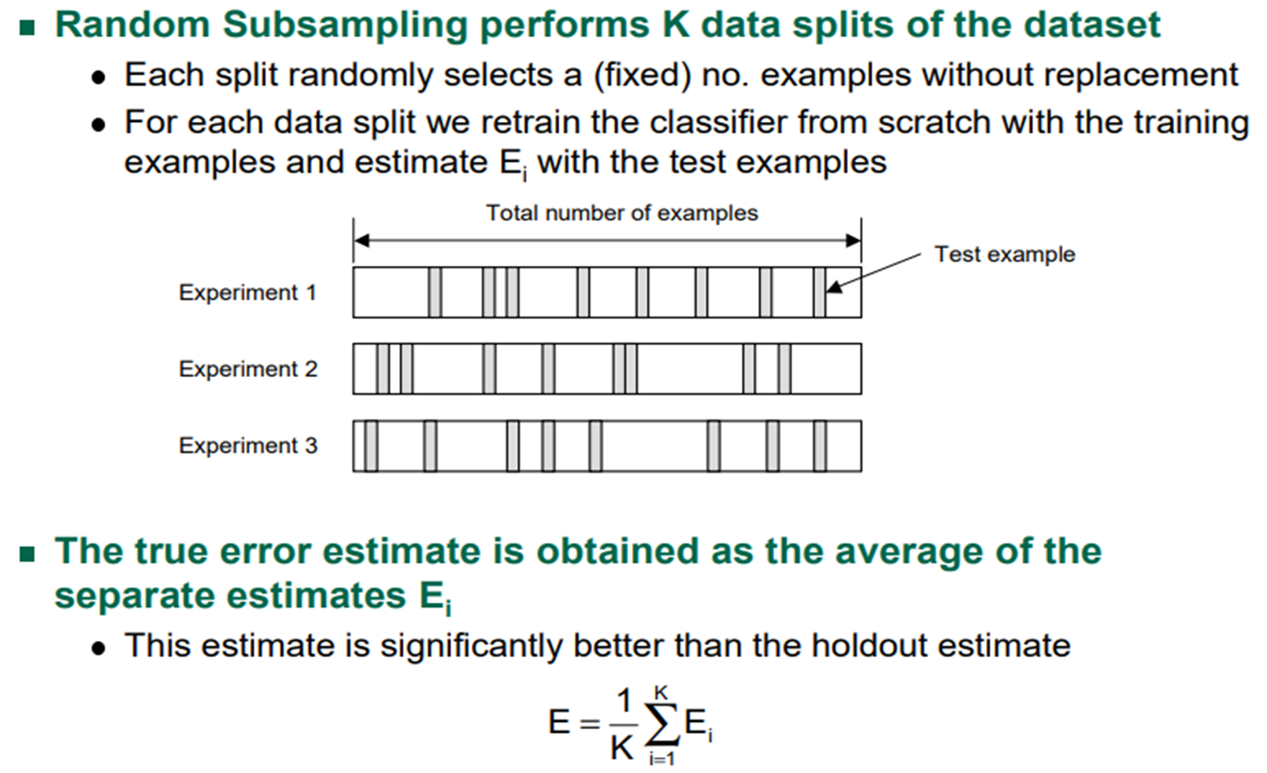
Techniques To Evaluate Accuracy of Classifier: Random Sampling
Random subsampling is a variation of the holdout method. The holdout method is been repeated K times.
The holdout subsampling involves randomly splitting the data into a training set and a test set.
21

Slide 22
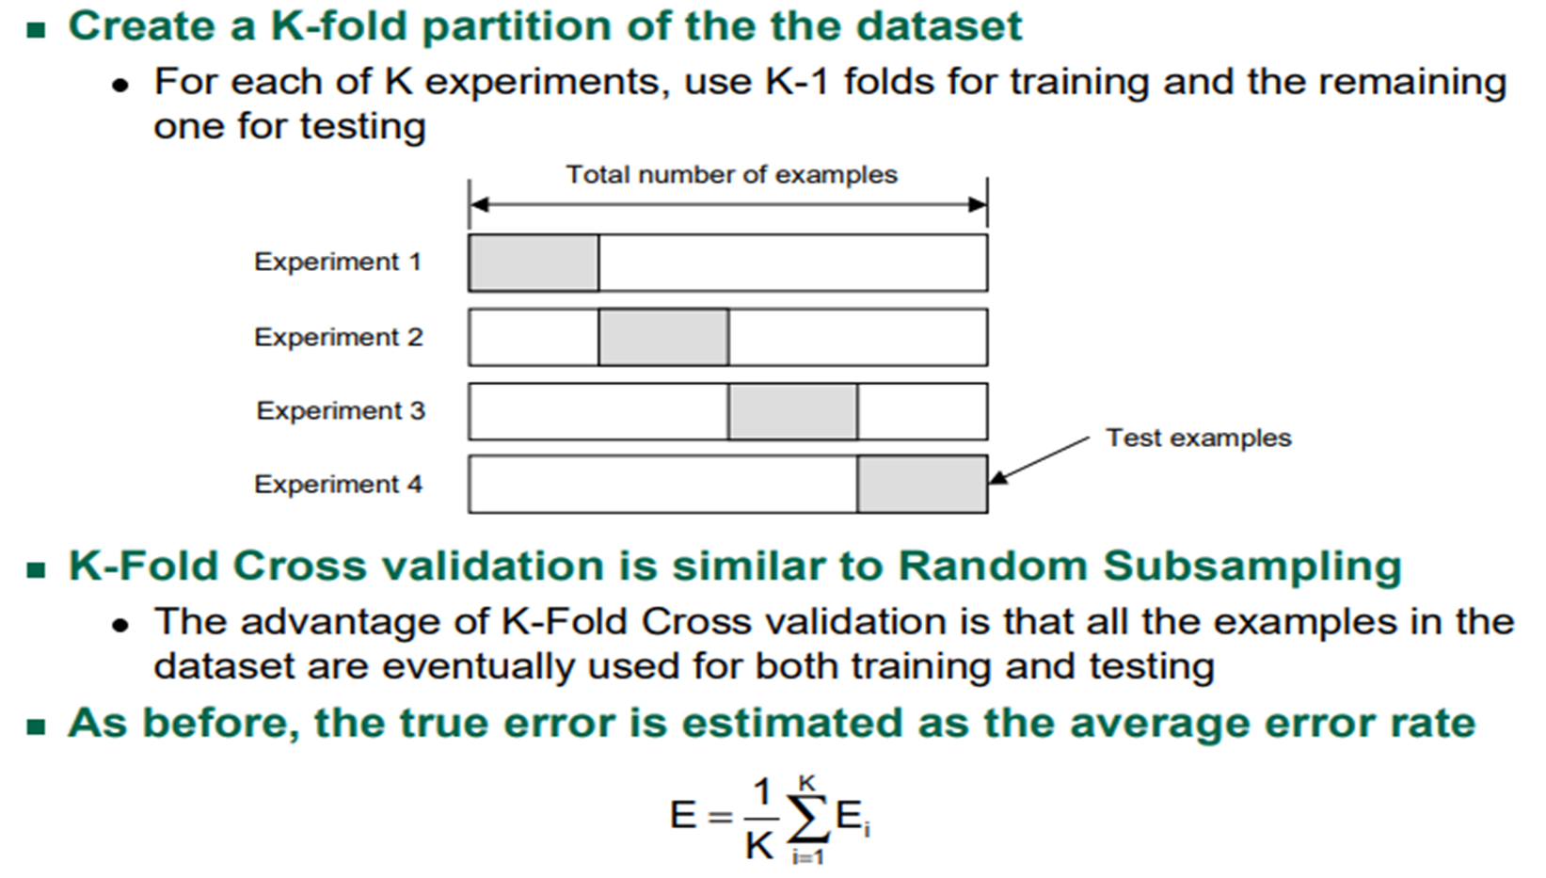
Techniques To Evaluate Accuracy of Classifier : K- Cross validation
22

Slide 23
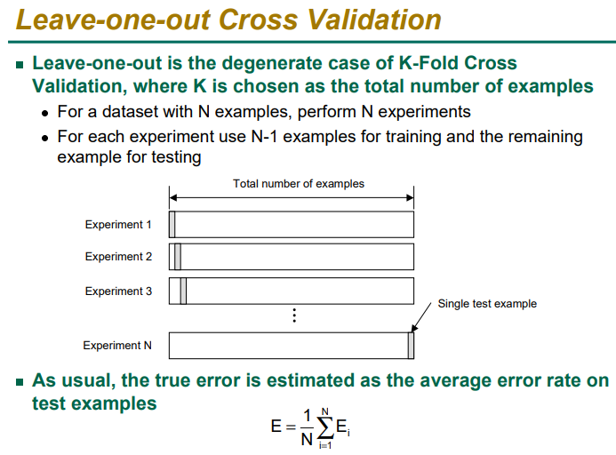

Slide 24
Evaluating Classifier Accuracy: Bootstrap
Bootstrapping
Bootstrapping is one of the techniques which is used to make the estimations from the data by taking an average of the estimates from smaller data samples.
The bootstrapping method involves the iterative resampling of a dataset with replacement.
On resampling instead of only estimating the statistics once on complete data, we can do it many times.
Repeating this multiple times helps to obtain a vector of estimates.
Bootstrapping can compute variance, expected value, and other relevant statistics of these estimates.
24

Slide 25
Techniques to Improve Classification Accuracy

Slide 26
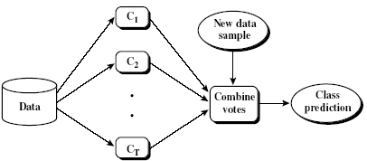
Ensemble Methods: Increasing the Accuracy
Ensemble methods
  Use a combination of models to increase accuracy
  Combine a series of k learned models, M₁, M₂, …, M_{k}, with the aim of creating an improved model M*
Popular ensemble methods
  Bagging: averaging the prediction over a collection of classifiers
  Boosting: weighted vote with a collection of classifiers
  Ensemble: combining a set of heterogeneous classifiers
26

Slide 27
Ensemble Algorithms
These algorithms combines the decisions from multiple models to improve the overall performance.
This approach allows the production of better predictive performance compared to a single model.
Advantage : Improvement in predictive accuracy.
Disadvantage : It is difficult to understand an ensemble of classifiers.
Basic Ensemble Techniques
Max Voting, Averaging, Weighted Average
2. Advanced Ensemble Techniques
Stacking, Blending, Bagging, Boosting
3. Algorithms based on Bagging and Boosting
Bagging : Bagging meta-estimator
Random Forest
Boosting: AdaBoost ,GBM, XGB, Light GBM, CatBoost

Slide 28
Why do ensembles work?
It address the following problems
Statistical Problem
The Computational Problem arises when the learning algorithm cannot guarantees finding the best hypothesis.
Representational Problem
The Representational Problem arises when the hypothesis space does not contain any good approximation of the target class(es).

Slide 29
Types of ensemble method
There are many ensemble techniques available, but we will discuss about the below two most widely used methods:
1. Bagging
2. Boosting
Let us first understand the similarities and differences between both terminologies.
Both the methods can be used for classification (discrete output) and regression (continuous output) problems.
­Both methods are better in performance compared to single models as they aggregate the output of all the weak learners via voting thereby leading to more accuracy in the predictions.

Slide 30
Bagging( Bootstrap Aggregation)
Bagging (Bootstrap Aggregation) is used to reduce the variance of a decision tree. Suppose a set D of d tuples, at each iteration i, a training set D_{i} of d tuples is sampled with replacement from D (i.e., bootstrap).
Then a classifier model M_{i} is learned for each training set D < i.
Each classifier M_{i} returns its class prediction.
The bagged classifier M* counts the votes and assigns the class with the most votes to X (unknown sample).

Slide 31
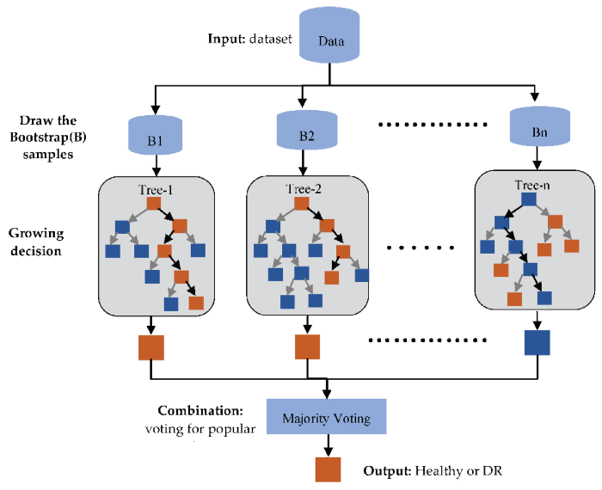
Implementation steps of Bagging(Bootstrap)
Multiple subsets are created from the original data set with equal tuples, selecting observations with replacement.(Row sampling replacement)
A base model is created on each of these subsets.
Each model is learned in parallel from each training set and independent of each other.
The final predictions are determined by combining the predictions from all the models. Classify by majority voting

Slide 32
Boosting
The idea of Boosting method is that instead of using a simple algorithm, which is not strong enough to make the accurate predictions alone as there are high variance and error rate, we combine multiple simple learning algorithms together, rather than finding a single highly accurate prediction rule.
The Boosting algorithm then combines these multiple weak rules together to reduce variance and bias in individual model rules into a single prediction rule, such that it will be much more accurate than any one of the weak rules as.

Slide 33
Boosting
Two fundamental approaches for effective implementation of Boosting algorithm:
Choosing the different subsets from training dataset for different iterations:
  To increase the efficiency of the base learner predictions, high weightage is placed on the examples that were misclassified by earlier weak learner.
How to combine weak leaners together:
  Taking a weighted majority vote of the predictions.

Slide 34
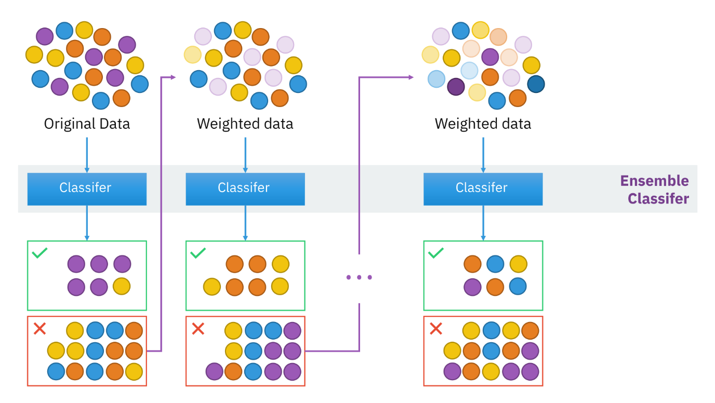
Boosting

Slide 35
Boosting Algorithm
Step 1: All observations have equal weight in the original training data set D₁. An initial “base” classifier h₁ is determined.
Step 2: The observations that were incorrectly classified by the previous base classifier have their weights increased, while the observations that were correctly classified have their weights decreased.
This gives us data distribution D_{m}, m=2, … , M.
A new base classifier hm, m = 2, … , M is determined, based on the new weights. This step is repeated until the desired number of iterations M is achieved.
Step 3: The final boosted classifier is the weighted sum of the M base classifiers

Slide 36
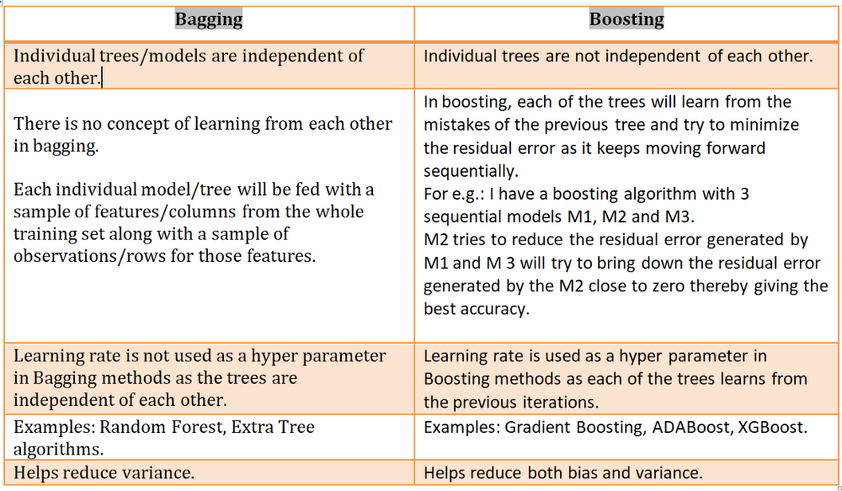
Differences Bagging and Boosting

Slide 37
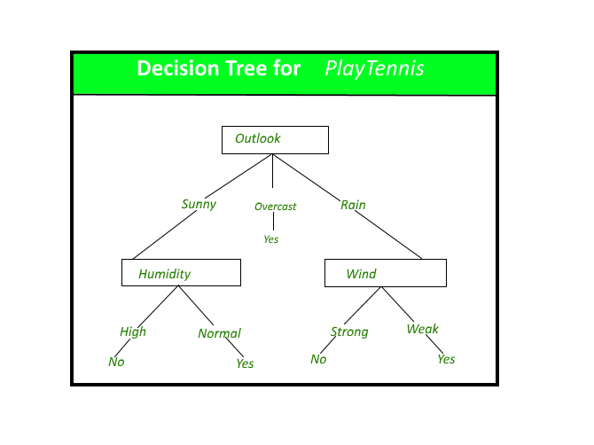
Decision tree: Its issues
Decision tree is the most powerful and popular tool for classification and prediction.
A Decision tree is a flowchart like tree structure, where each internal node denotes a test on an attribute, each branch represents an outcome of the test, and each leaf node (terminal node) holds a class label.
Issues:
Overfitting the data: High variance, low bias
Guarding against bad attribute choices
Handling continuous valued attributes
Handling missing attribute values
Handling attributes with differing costs

Slide 38
Random forest
Random reduce high variance in Decision tree.
A Random forest is an ensemble learning method where multiple decision trees are constructed , trained by Bagging method and then they are merged to get a more accurate prediction.
Random forest is a supervised learning algorithm which is used for both classification as well as regression.
Forest is made up of trees and more trees means more robust forest.
Random forest algorithm creates decision trees on data samples and then gets the prediction from each of them and finally selects the best solution by means of voting.
It is an ensemble method which is better than a single decision tree because it reduces the over-fitting by averaging the result.

Slide 39
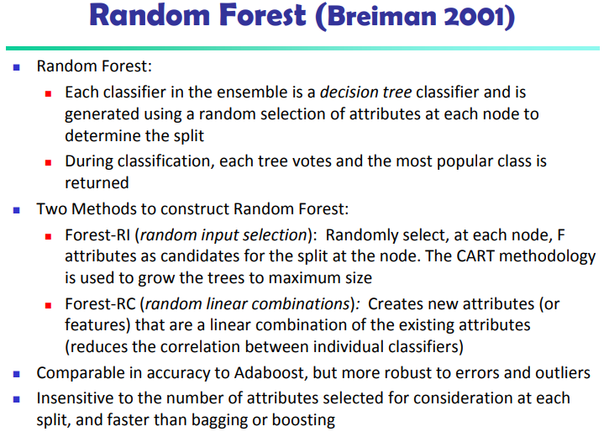

Slide 40
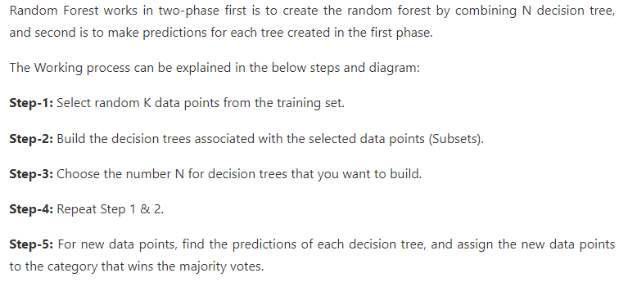
Random Forest

Slide 41
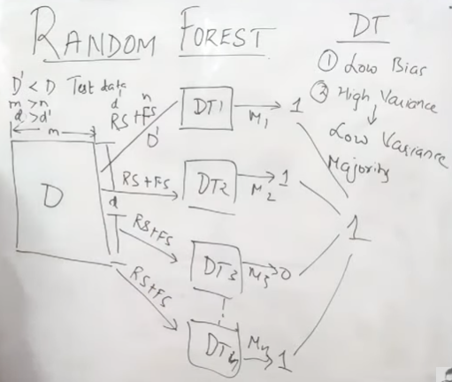
Random forest

Slide 42
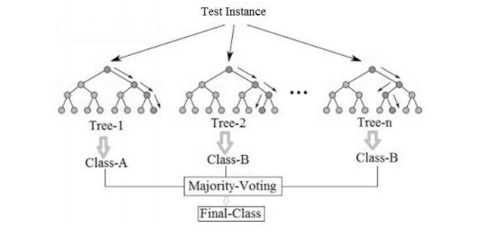
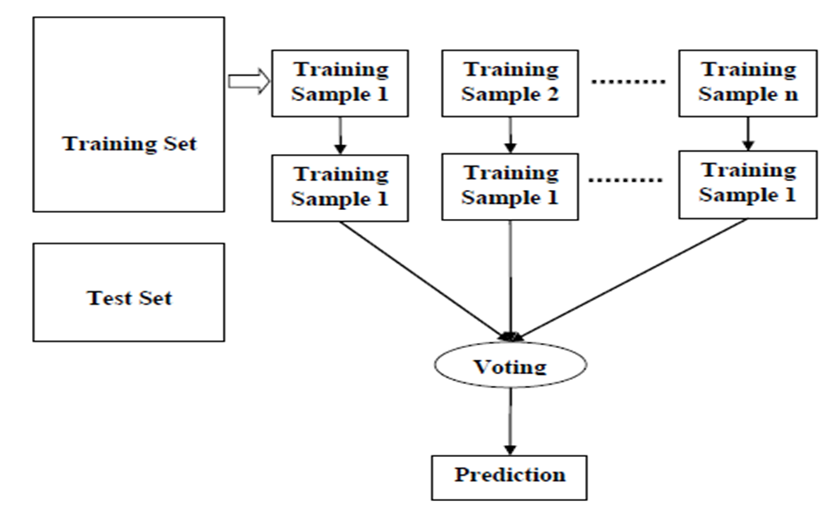
Example of random forest with majority voting

Slide 43
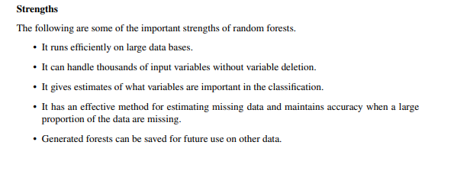
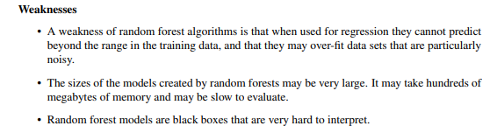
Strengths and weakness

Slide 44
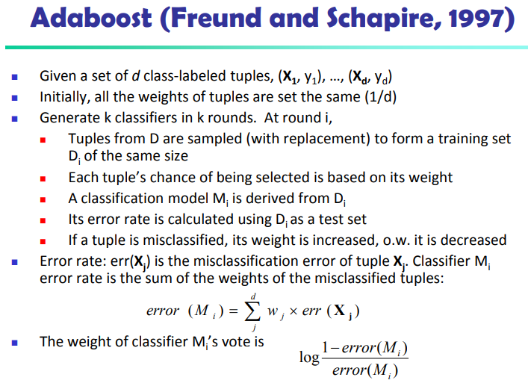

Slide 45
Classification of Class-Imbalanced Data Sets
Class-imbalance problem: Rare positive example but numerous negative ones, e.g., medical diagnosis, fraud, oil-spill, fault, etc.
Traditional methods assume a balanced distribution of classes and equal error costs: not suitable for class-imbalanced data
Typical methods for imbalance data in 2-class classification:
  Oversampling: re-sampling of data from positive class
  Under-sampling: randomly eliminate tuples from negative class
  Threshold-moving: moves the decision threshold, t, so that the rare class tuples are easier to classify, and hence, less chance of costly false negative errors
  Ensemble techniques: Ensemble multiple classifiers introduced above
Still difficult for class imbalance problem on multiclass tasks
45

Slide 46
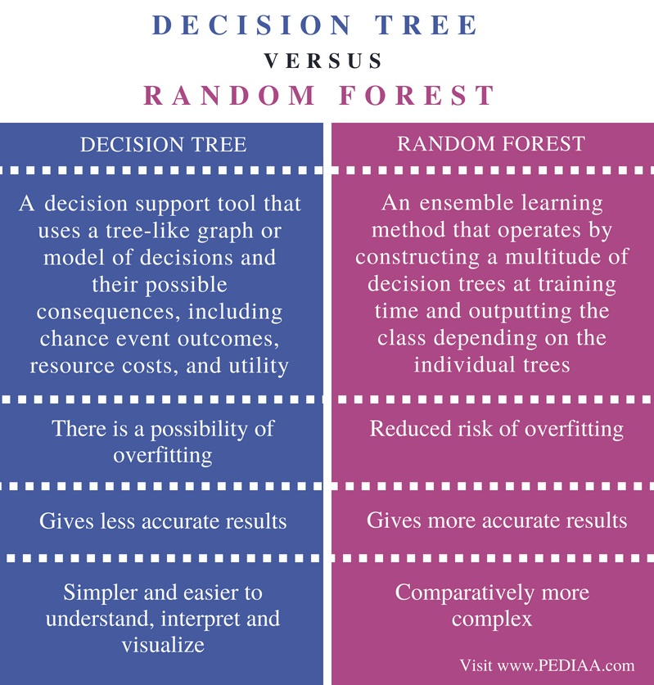
Difference between Decision tree, Random forest

Slide 47
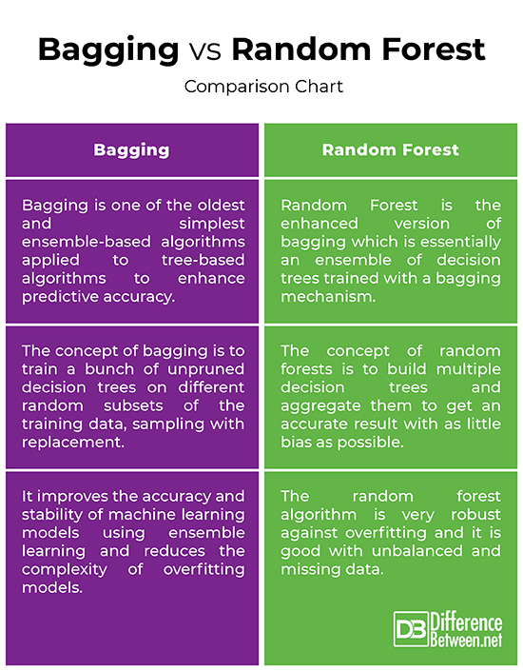
Difference between Bagging vs Random forest

